Slide 1


SAP Full-Stack Developer training
ABAP on HANA, UI5 & Fiori, Analytics with OData
Anubhav Oberoy
Day – 9

Slide 2

Agenda – Day 9
Git Hub Using Command Line
Git Hub Using BAS UI
Fiori Design and Development Process
Central HUB – What exist where?
Developer personas
--Break--
Getting started with a fresh user – Business User
Fiori Security Expert/Fiori Administrator
Configuration v/s Customizing v/s Personalization
Some Standard SAP Roles in S/4HANA
Rapid Deployment – Best Practice
Concept of Task List
Fiori Rapid Activation – Further Read

Slide 3
Git Hub Using Command Line
Create Git Repo From command line (First push):
Open the terminal, and Open your Project folder
Run Command git init
git add .
git commit -m "first commit“
git branch -M main
git remote add origin https://github.com/<Git-id>/<Repo-name>.git
git push -u origin main
Pushing to an Existing From command line:
git add .
git commit -m “<message>"
git push

Slide 4
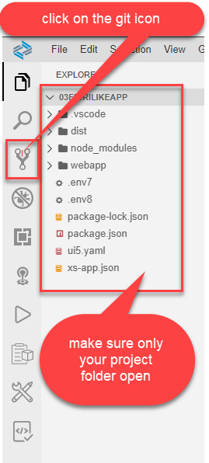
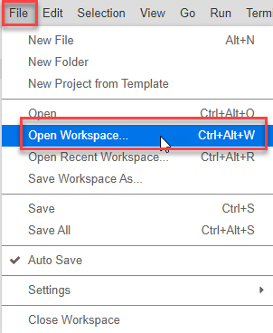
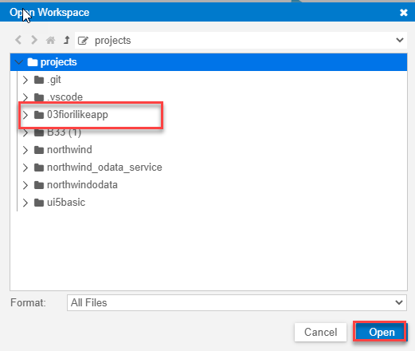
Git Hub Using BAS UI
Opening the project in the workspace

Slide 5
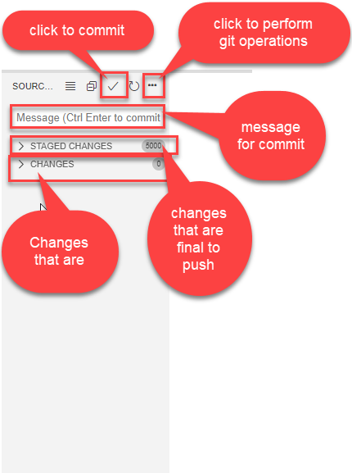
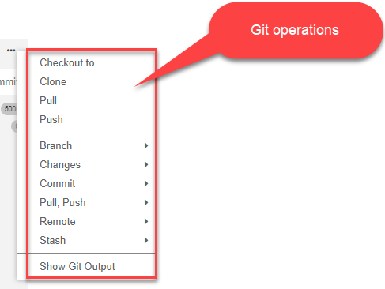
Git Hub Using BAS UI
After click on git, git tab is open where we can see our changes and also commit them & push to the git

Slide 6
Fiori Design and Development Process
Tool and Setup
Deployment
Maintenance
Design
Prototype (PoC)
Development
Testing
DevOps
2017
SAP WebIDE
(local comp.)
2020-21
VS Code(free)
Local- plugin
2012
Eclipse
2017
WebIDE Full Stack (cloud)
2020
BAS – Business App Studio (BTP)
Multi-cloud development tool
Which can be used to develop FioriApps, HANA Native, Hybrid, CAPM

Slide 7
Central HUB – What exist where?
BAS
Fiori Frontend system (FES)
SAP_GWFND, SAP_UI, UIS4OP1
System Alias, RFCs
All Fiori Apps
SAP Fiori Launchpad /ui2/flp
Roles
OData Registration
Roles
Browser
Fiori Content
Roles, Group, Catalog
Fiori Launchpad Designer /ui2/flpd_conf
/ui2/theme_designer
Same frontend user must exist in backend also
SAP Fiori Backend System (BES)
IW_BEP, S4CORE
Existing Z and SAP TCode
Backend Content
Applications and Data
Develop OData Services
MPC and DPC classes

Slide 8
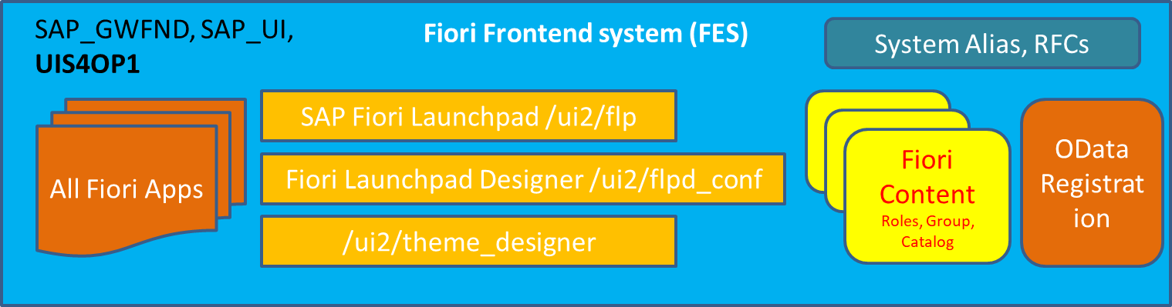
Developer personas
Fiori Architect
SAP Basis Consultants
Arrange the hardware
Plan for system installation
Create Stack.xml and install
Upgrade systems
Download and apply SAP notes
Maintain system health and backup
Overall security and user management
GRC Consultant
SAP Fiori Administrator/ Fiori Security Consultants
Install Fiori Apps
Check and verify if the components are available
Conduct fit-to-standard workshop
Identify Scope
Configure Roles in Fiori system
Manage the deployment of Fiori apps
Run Task lists
Create users who work with Fiori
Create Sample users for testing
Configuring and Adaption of Standard SAP Content
Standard Fiori App activation
Troubleshoot Fiori apps
Configure Custom apps according to need, develop new custom content and roles
Design Launchpad pages
Entire Company theming experience for Fiori
Change login and logout pages
Key Users – Non technical
Little technical knowledge on UI5
Non-coding background
Enhance Fiori apps with minor adaptions which we call key-user extensibility in S/4HANA
Customization changes in SAP system
Configure apps like My Inbox fiori app
Customize Analytic Apps
Use S/4HANA embedded Analytics to develop new type of apps - KPI Tiles
Query Browser
KPI Tiles
OVP
ALP
APF
UI5 Fiori Developers
Setup the development tools like BAS, VS Code
Create Secure connection using Cloud Connector and maintain destinations
Developing custom Fiori Apps – Using Annotations or Free Style
Developing OData Services and Activation of Services
Create Custom apps of different kinds
Troubleshoot apps
Deploy Fiori Apps developed in company to SAP System
Work with SAP BTP to open app on SAP CF
Extensive knowledge on JS and Node JS
Build unit and integration test
Create CI/CD pipelines
Advocate the development team
Create Fiori Prototypes
https://training.sap.com/certification/c_fioad_1909-sap-certified-technology-associate---sap-fiori-system-administration-g/

Slide 9

Break
Trainer: Anubhav Oberoy

Slide 10

Getting started with a fresh user – Business User
Create a new user ALEX in tcode SU01
Warning – If you took server from Anubhav Training, we will not allow access to this tcode
When Alex login with the his user, Alex wont be able to access launchpad. /n/UI2/FLP
Once alex open launchpad, he wont be able to see any tile, infect he will see an error
Since it’s a fresh system the Fiori Related Service wont be active so we will register them first
Alex will have further issues accessing the service because of authorization, Create a role which we will grant access to alex.
Any Service has 2 parts, 1. metadata IWSV 2. content IWSG, We need to grant access of /UI2/INTEROP and /UI2/PAGE_BUILDER_PERS
Allow visibility of tile /UI2/CHIP and S_PB_CHIP, these 2 authorization objects must also be assigned to the user through role.
Alex
Sales Representative
SAP make our life Simple –
A existing Template role which is having all the required information related to access of launchpad. – SAP_UI2_USER_700
Make a copy
Add the necessary IWSG for INTEROP and PAGE_BUILDER_PERS service
Create profile
Assign to the user and test using that user
Users should have as minimal as possible authorizations to perform their job

Slide 11

Fiori Security Expert/Fiori Administrator
In order to enable our SAP Security consultant to access fiori launchpad designer, we need following authorizations
Transaction code /n/UI2/FLPD_CONF and /n/UI2/FLPD_CUST
URL is https://hostname:port/sap/bc/ui5_ui5/sap/arsrvc_upb_admn/main.html?scope=CONF&sap-client=800&sap-language=EN
Following are the list of OData services required to access Fiori launchpad designer and its features
/UI2/PAGE_BUILDER_CONF – loads all the available content from configuration layer
/UI2/PAGE_BUILDER_CUST – loads all the available content from customizing layer
/UI2/TRANSPORT – Used by the launchpad designer to read transports from ABAP system so when we design content in the launchpad designer, it can be transported to the Q and P System
Insert following authorizations using auth template
/IWFND/RT_ADMIN
/IWBEB/RT_BEP_ADM
/IWBEP/ET_MGW_ADM
/IWNGW/RT_WF_ADM
/IWFND/RT_DEVELOPER
SAP Provides a template role for Administrators which you can use to speed up your Admin role Creation
SAP_UI2_ADMIN_700
Kim (BUSER)
Fiori Security Expert

Slide 12
Configuration v/s Customizing v/s Personalization
Personalization
User specific settings like color theme, settings, Variants, Settings in table only affect the user who did it. This is takes highest priority over the other settings. E.g. Themes in gmail.
Only single user.
Customizing
/ui2/flpd_cust
Customizing Request
Settings which is applicable for All users belonging to a particular client. Customizing’s are always client specific. So suppose we want to give access to a set of users an extra set of tiles in system, then we can use LPD designer in that client with CUST mode.
Configuration
/ui2/flpd_conf
Workbench Type of request
Settings which are applied at entire system level irrespective of Client. If we create a tile in Fiori launchpad designer in CONF mode, this tile will be visible to everyone in the system. We should ideally use always the CONF layer for the tile.
500 users – if I change configurations?
Client 100 – 300 users
Client 200 – 200 users

Slide 13
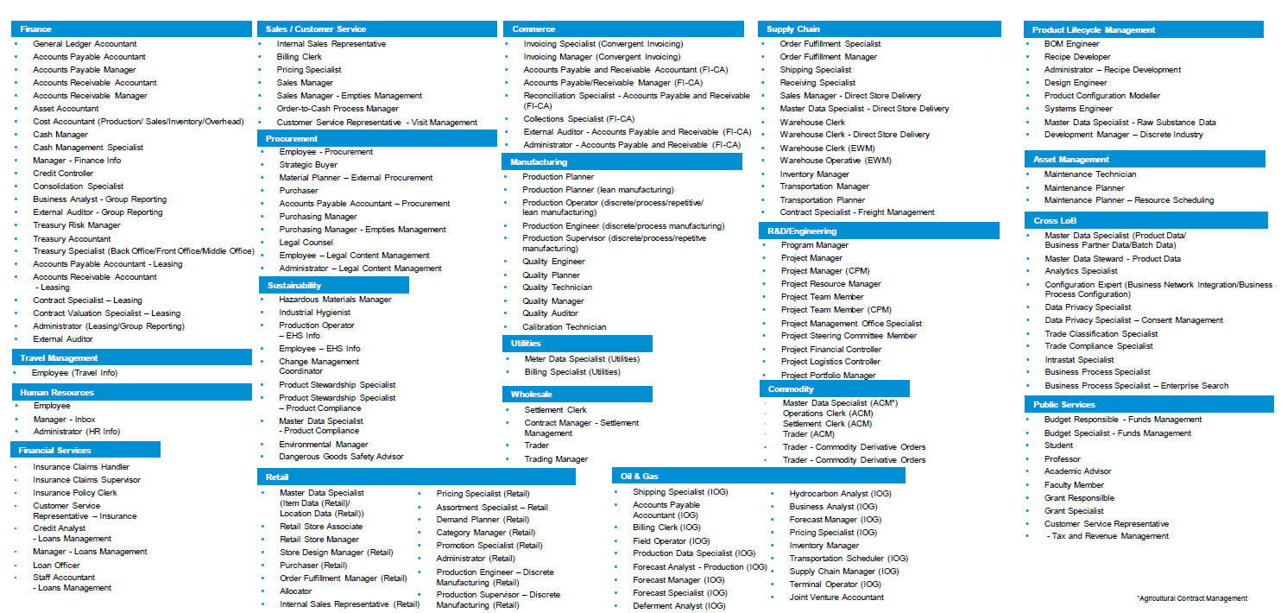
Some Standard SAP Roles in S/4HANA

Slide 14
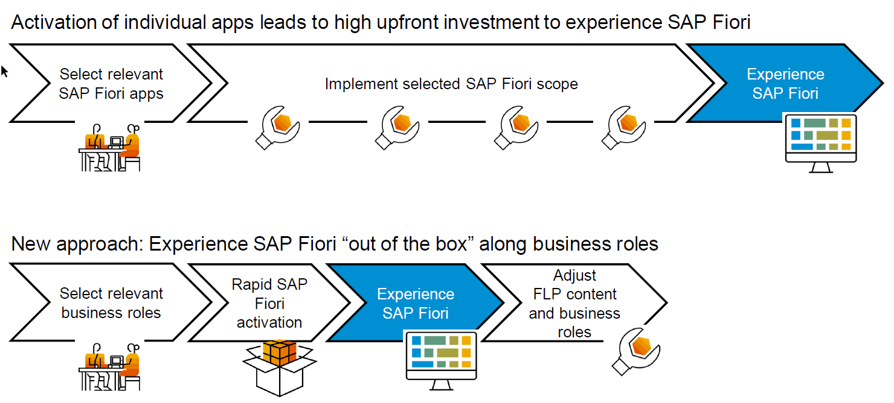
Rapid Deployment – Best Practice

Slide 15
Concept of Task List
SAP NW 7.4 onwards there is a new concept of Task list – Tcode – STC01
Instead of doing multiple manual activities, we can do a one click execution of task list and the task list is designed to work in sequence and execute all the work in automatic way.
The task list approach only applies to S.4HANA
It work for both Embedded and Central HUB, we need to follow SAP guidance on task list if we using different system
Starring S/4HANA 1809
SAP_GW_FIORI_ERP_ONE_CLNT_SETUP – Responsible for Activating SAP Gateway and Entire Fiori Launchpad (and designer)
SAP_ESH_INITIAL_SETUP_WRK_CLIENT – Activating Enterprise search
SAP_FIORI_FOUNDATION_S4 – Responsible for deploy Fiori like set theme, create launchpad and admin role
SAP_FIORI_CONTENT_ACTIVATION – Activate Apps and services for the apps

Slide 16


Use case
You have recently joined as a FIORI SECURITY consultant to one of S/4HANA project Running @Anubhavtrainings.com
In the company, we have several departments like SALES, HR, Finance, Marketing.
You have been invited by Sales department to solve their challenge and needs of Fiori apps needed at different levels in organization.
Before you joined there was a SAP Fiori Security consultant in the team, who simply granted the template role access to the users as it is delivered by SAP. Though all the required apps by sales team are accessible but they are only using hardly 20% of the apps granted to them. The goal is to optimize the launchpad for sales department (which includes sales representative and sales manager). We need to adjust the SAP Fiori Launchpad content as per below requirement
Sales Representative
Sales Manager
ALEX
NOLAN
ZATS_BR_SALES_REP_XX - ZATS_BC_SALES_REP_XX
ZATS_BR_SALES_MGR_XX – ZATS_BC_SALES_MGR_XX
Sales
Inquiry
quotation
Manage SO
ZATS_BCG_MGR_XX
ZATS_BCG_MSS_XX
Manage SO
Analyze SO fulfilment
Sales Manage
ZATS_BCG_SLS_XX
ZATS_BCG_ESS_XX
Create leave req
My Timesheet
Create leave req
My Timesheet
My Inbox
MSS
ESS
Portal website
ZATS_BC_PORTAL
ZATS_BCG_PORTAL
Portal website

Slide 17
Sales Representative Role bulding
-- Build Custom Business Catalog
1. Create a new Catalog in Launchpad designer ZATS_BC_SALES_REP_XX
2. Then open SAP Standard catalog - Technical catalog - SAP_TC_CEC_SD_COMMON
3. Search apps which are needed from sales Area
3.1 Manage Sales Order
3.2 Inquiry
3.3 Quotation
Drag and create a reference of these tiles to our BC
4. Search and select the target mappings for SalesOrder-manage, Quotation-manage, Inquiry-manage and Create reference button to also reference to the BC
5. in App Ref Lib find the catalog for HR apps SAP_HR_TC_T
6. Repeat Same steps to create ref. of Leave Request, Timesheet Apps to our BC
Target mappings are LeaveRequest-manage and TimeEntry-manage
7. Check your BC - It should have 5 Tiles and mappings

Slide 18
- - -Groups
1. Switch to groups tab
2. Create 2 groups - 1. sales - Anubhav 2. ESS- Anubhav
ZATS_BCG_SLS_XX
ZATS_BCG_ESS_XX
3. Select our catalog and add tiles to these groups
-- Role
1. Create a new Role in PFCG - ZATS_BR_SALES_REP_XX
2. Like yesterday, add our group and catalog to the role
3. Add also the one ANubhav Created -
ZATS_BCG_PORTAL
3. Generate profile
4. Grant to alex

Slide 19
Fiori Rapid Activation – Further Read
For everyone:
SAP Fiori for SAP S/4HANA wiki
For IT Leaders:
Mapping Your Journey to SAP S/4HANAA Practical Guide for Senior IT Leadership
For project managers:
Top 10 Myths and Misconceptions
Essential Roles for SAP S/4HANA Projects
For the whole project team:
Speed up your Fiori support
–Guided answer: How to create the perfect Fiori Incident
For functional consultants:
Top 5 Fiori features that bring value to every business user
Best UX resources for Functional Consultants
Finding the delta of new apps between SAP S/4HANA versions
Finding the technical name of an app
For the technical team:
Fiori rapid content activation–4 part series
How to extend Fiori apps
–Guided answer: How to extend a SAP Fiori app in SAP S/4HANA
–Understanding extensibility: UI flexibility
Performance tips and tricks -S/4HANA on premise
Readiness Check 2.0 –Details about the topic of Fiori
Internet facing considerations and recommendations

Slide 20

End of Day 9

Slide 21

Questions

Slide 22

Anubhav Oberoy

Slide 23


We’re committed to empower you to be
Most Desirable Resource
through powerful training solutions.
We build the workforce of the future.
250+
Corporate Clients
30,000+
Learners Trained
25000+
Learners Placed
FREE WEBINARS
Sign up for free webinars with industry experts every fortnight!
Enroll Now!
Contact us today!
https://anubhavtrainings.com/

Slide 24




More from AnubhavTrainings.com

Slide 25
Title
Content

